Slide 1


Python + IOT
Course 1
Ver. 01
Copyright @ 2018 Innovaker

Slide 2

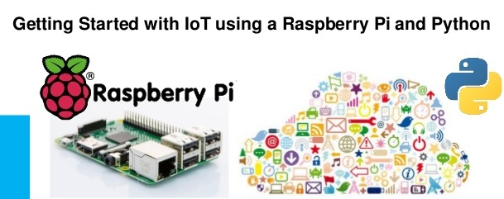
Course 1 Summary
Quick review of the Python programming
Introduction of Internet of thing
Interactive Python IDE with Visual Debugger
http://www.codeskulptor.org/viz/index.html
2
Copyright @ 2018 Innovaker

Slide 3
Quick review of Python Programming
Python is a modern, easy-to-learn, object-oriented programming language, it can be used to make all sorts of projects, include game, web design, app, etc.
Python is an interpreted language
. Python is easy to learn
. Python is broadly used and supported
. Python is not a “toy” language
. Python is used for general application programming
. Python is used for data science and machine learning
. Python is used for web services and RESTful APIs
3
Copyright @ 2018 Innovaker

Slide 4

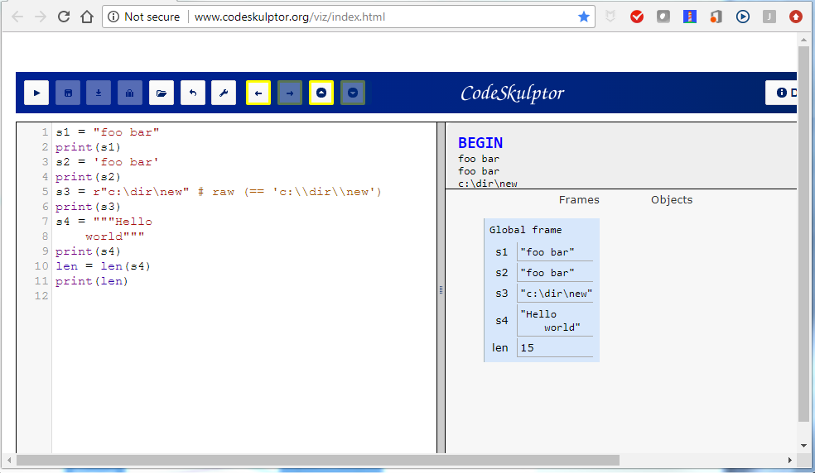
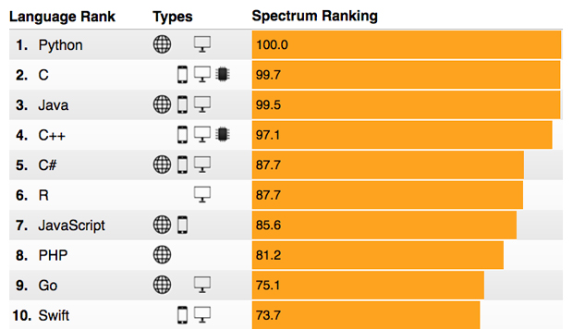
Python
Data types
String
s = "foo bar"
s = 'foo bar'
s = r"c:\dir\new" # raw (== 'c:\\dir\\new')
s = """Hello
world"""
s.join(" baz")
n = len(s)
"Ala ma {} psy i {} koty".format(2,3)
"Square root of 2 is equal to {:.2f}".format(math.sqrt(2))
Copyright @ 2018 Innovaker

Slide 5
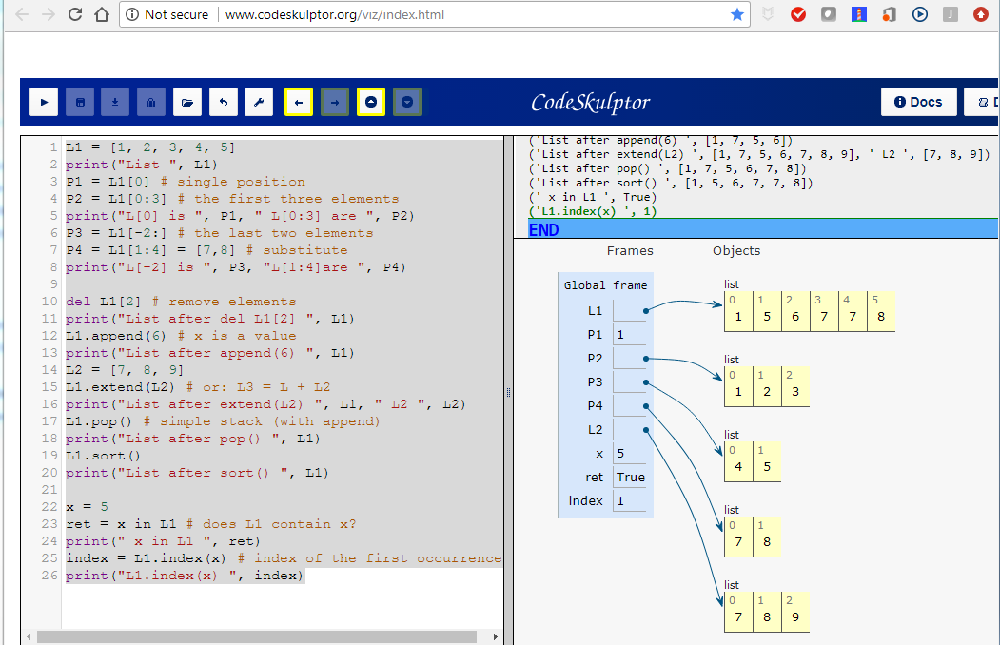
Python
Data types
Lists
L = [1, 2, 3, 4, 5]
L[0] # single position
L[0:3] # the first three elements
L[-2:] # the last two elements
L[1:4] = [7,8] # substitute
del L[2] # remove elements
L.append(x) # x is a value
L.remove(x)
L.extend(L2) # or: L3 = L + L2
L.pop() # simple stack (with append)
L.sort()
x in L # does L contain x?
L.index(x) # index of the first occurrence
[x*2 for x in L if x>2] # list comprehensions
Copyright @ 2018 Innovaker

Slide 6
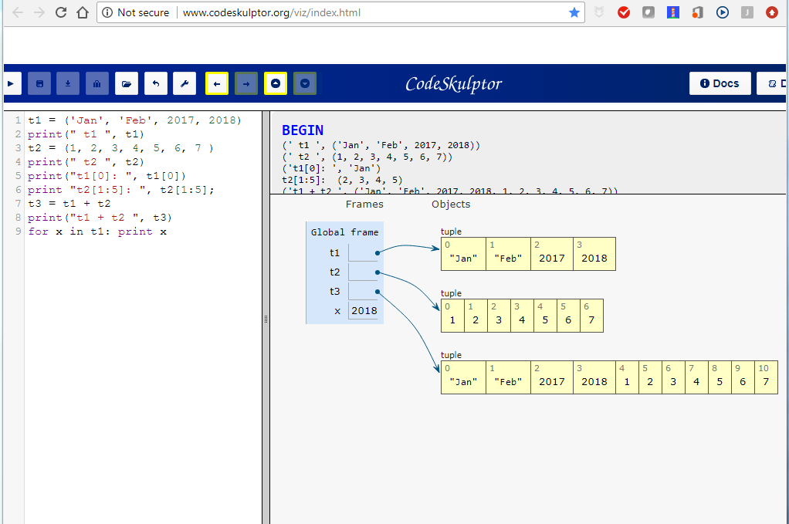
Python
Data types
Tuples
x = 1,2,3
x = (1,2,3)
x[1]
a,b,c = x
Copyright @ 2018 Innovaker

Slide 7
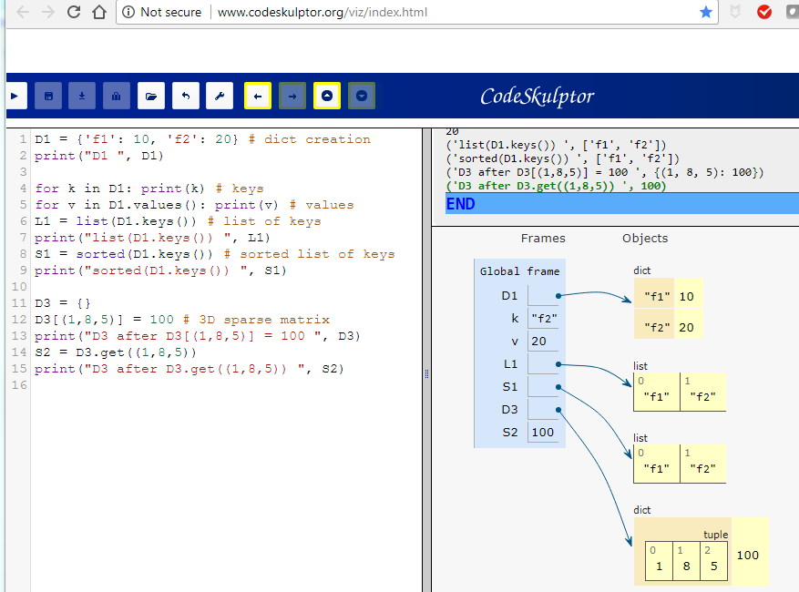
Python
Data types
Dictionaries
D = {'f1': 10, 'f2': 20} # dict creation
D = dict(f1=10, f2=20)
keys = ('a', 'b', 'c')
D = dict.fromkeys(keys) # new dict with empty values
for k in D: print(k) # keys
for v in D.values(): print(v) # values
for k, v in D.items(): # tuples with keys and values
list(D.keys()) # list of keys
sorted(D.keys()) # sorted list of keys
D = {}
D[(1,8,5)] = 100 # 3D sparse matrix
D.get((1,8,5))
Copyright @ 2018 Innovaker

Slide 8
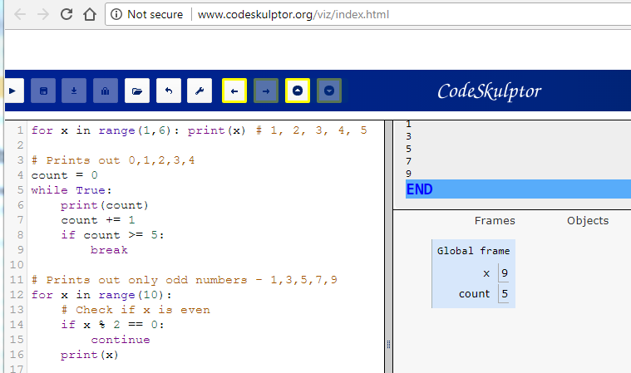
Python
Loops
for x in range(6): # 0, 1, 2, 3, 4, 5
for x in range(1,6): # 1, 2, 3, 4, 5
for x in range(1,6,2): # 1, 3, 5
for k,v in D.items():
print("D[{}]={}".format(k,v)) # D[f1]=10 D[f2]=20
L = [1, 3, 5]
for i,v in enumerate(L): # (index,value)
for x,y in zip(L1,L2): # returns tuples
for i in sorted(set(L)): print(i) # sorted set from a list
for x in reversed(L1):
Copyright @ 2018 Innovaker

Slide 9
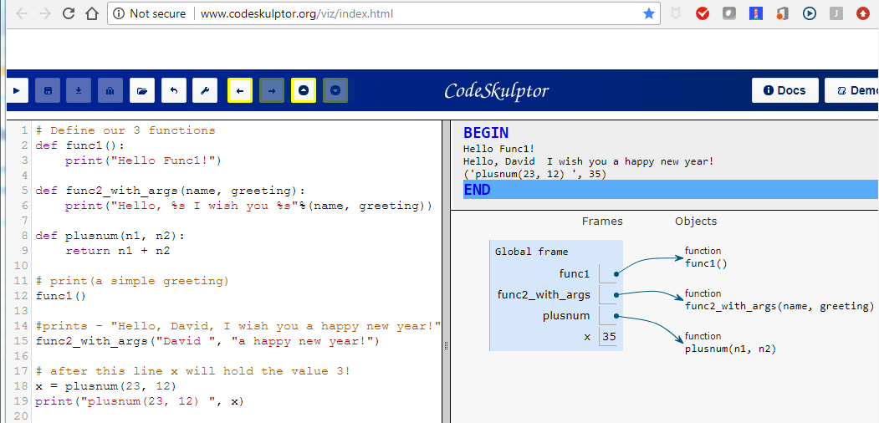
Python
Functions
def foo(arg1, *args, **dic):
"""Example documentation string.
This function does not do anything special. """
# arg1 is a positional argument
# args is a list
# dic is a dictionary of named arguments
def foo(a,b,c=0):
L = [1, 2, 3]
foo(*L) # unpacking a list of arguments
D = {'a': 10, 'b': 20} foo(**D)
# unpacking a dictionary of arguments
foo.__doc__ # the docstring
Copyright @ 2018 Innovaker

Slide 10
Python
Input / Output
Input & print
x = raw_input("Name: ")
for line in sys.stdin:
print(line)
#String input buffer
from StringIO import StringIO
buf = StringIO()
sys.stdout = buf
print("Hello")
x = buf.getvalue()
can not be demonstrate online
Copyright @ 2018 Innovaker
Notes:
can not be demonstrate online

Slide 11
Python
Input / Output
File access
f = open("test.txt", "w") # r / r+ / rb / rb+ / w / wb
f.write("Ala ma kota\n")
f.close()
for line in open("test.txt"):
print(line, end="")
L = open("test.txt").readlines() # returns a list of lines
can not be demonstrate online
Copyright @ 2018 Innovaker

Slide 12
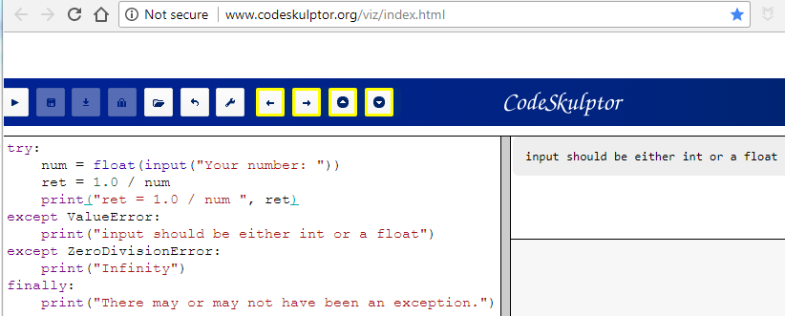
Python
Exceptions
try:
raise TypeError("arg")
except (RuntimeError, NameError):
pass # empty instruction (NOP)
except:
info = sys.exc_info()
print(info[0])
print(info[1])
traceback.print_tb(info[2])
raise else:
... # no exception but before finally
finally: # on the way out
... # unhandled exc, release resources
Copyright @ 2018 Innovaker

Slide 13
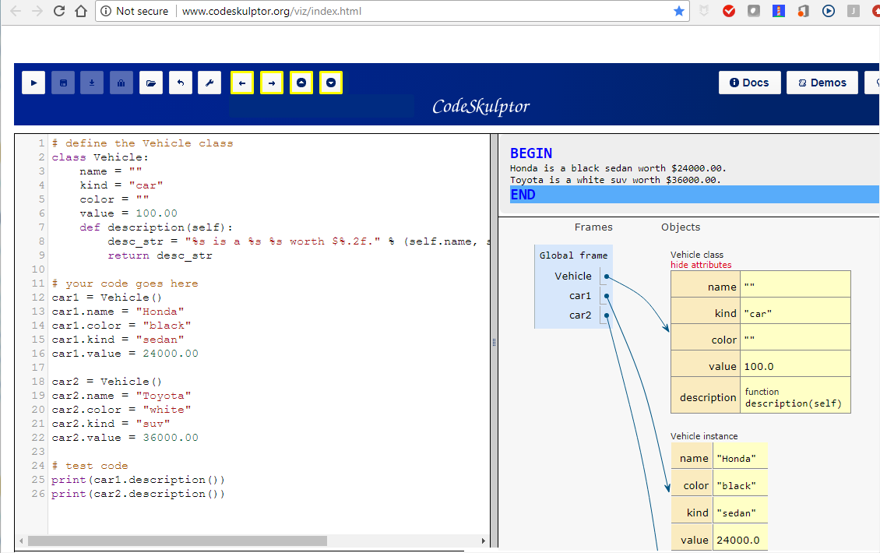
Python
Object oriented
programming
class Person:
ID = 0 # static variable
def __init__(self, name, age=0):
self.name = name
self.age = age
Person.ID += 1
self.ID = Person.ID
def lastName(self):
return self.name.split()[-1]
def __str__(self):
return "{}({},{})".format(self.__class__.__name__, self.name, self.age)
class Worker(Person):
def __init__(self, name, position, age=0):
super().__init__(name, age)
self.position = position
def __str__(self):
return "{}({},{},{})".format(self.__class__.__name__, self.name, self.position, self.age) bob = Worker("Bob Smith", "developer", 25) print(bob)
Copyright @ 2018 Innovaker

Slide 14
What is Internet of things?
The interconnection via the Internet of computing devices embedded in everyday objects, enabling them to send and receive data.
--- Oxford dictionary
The internet of things (IoT) is the network of physical devices, vehicles, buildings and other items—embedded with electronics, software, sensors, and network connectivity that enables these objects to collect and exchange data
--- wiki
14
Copyright @ 2018 Innovaker

Slide 15


What is Internet of things?
The interconnection via the Internet of computing devices embedded in everyday objects, enabling them to send and receive data. --- Oxford dictionary
The internet of things (IoT) is the network of physical devices, vehicles, buildings and other items—embedded with electronics, software, sensors, and network connectivity that enables these objects to collect and exchange data --- wiki
15
Copyright @ 2018 Innovaker

Slide 16
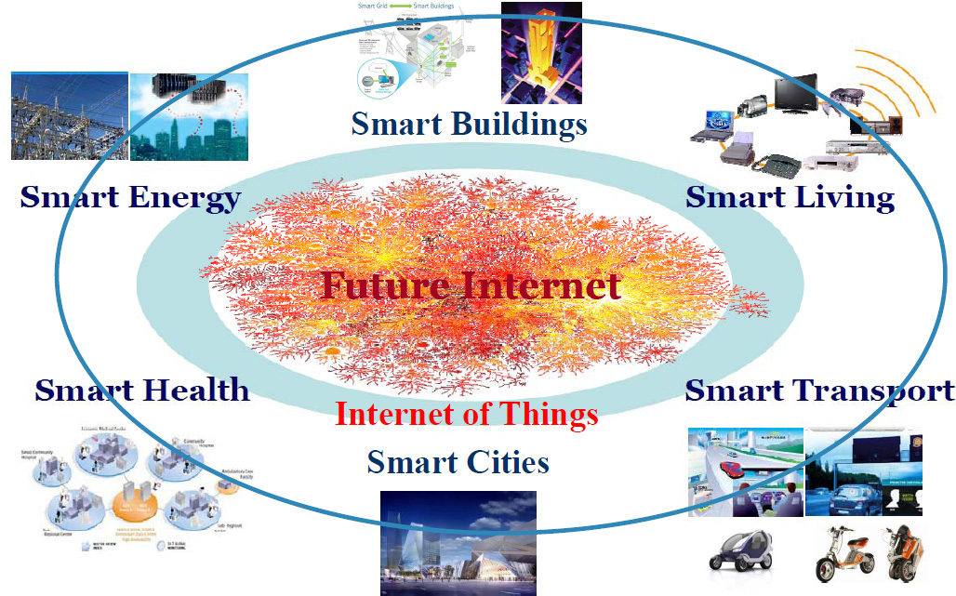
Internet of things
An IOT system comprises three basic Components.
. the things –-- sensors, actuators etc.
. the network
. the platforms, apps and service
16
Copyright @ 2018 Innovaker

Slide 17
Internet of things
The Things – Sensors and Devices
In contrast to computers and tablets which are the main devices currently connected to the Internet.
Internet of things devices will mainly be:
Low Power- Power usage and computational Power.
Low cost
Wireless
Examples are Simple sensors – temperature, pressure etc
To turn an everyday object like a house or a car into a smart house or car or a “thing” will require that the object has:
A unique address – IPv6 address
A way to connect to a network – Wireless
sensors e.g temperature,light,speed etc
17
Copyright @ 2018 Innovaker

Slide 18
Internet of things
IOT Networks
The Internet of things will utilize the existing networking infrastructure, technologies and protocols currently used in homes/offices and on the Internet, and will introduce many more.
Protocols are designed to operate at a particular level in the networking stack. TCP/IP uses a 4 level model and we will discuss IOT networking using this model.
However because of the requirement for low powered end devices there will be major developments in the Wireless connectivity protocols.
Wi-Fi and Bluetooth are being actively developed for low powered applications and there are new connection technologies like LPWAN, ZigBee, 6LoWpan and Thread.
18
Copyright @ 2018 Innovaker

Slide 19
Internet of things
IOT Platforms, Apps and Services
An IOT platform combines several IOT functions in one.
It can collect and distribute data, convert data between protocols, store and analyse data.
They are available as cloud based and standalone platforms and are available from many companies -large and small.
Examples
Amazon Web services (AWS)
IBM Watson Bluemix
Microsoft Azure
ThingWrox
19
Copyright @ 2018 Innovaker

Slide 20

Congratulations On Finishing
Copyright @ 2018 Innovaker

